Slide 1
PRODUCT ANALYSIS
Time to Purchase
How quickly same-day purchasers buy after first arriving
on the e-commerce website.
Analysis period: 2020-11-01 to 2021-01-31
Notes:
Introduce the project and the PM question: how quickly do same-day purchasers buy after first arriving on the e-commerce website? Keep this slide brief and move directly to the daily trend.

Slide 2
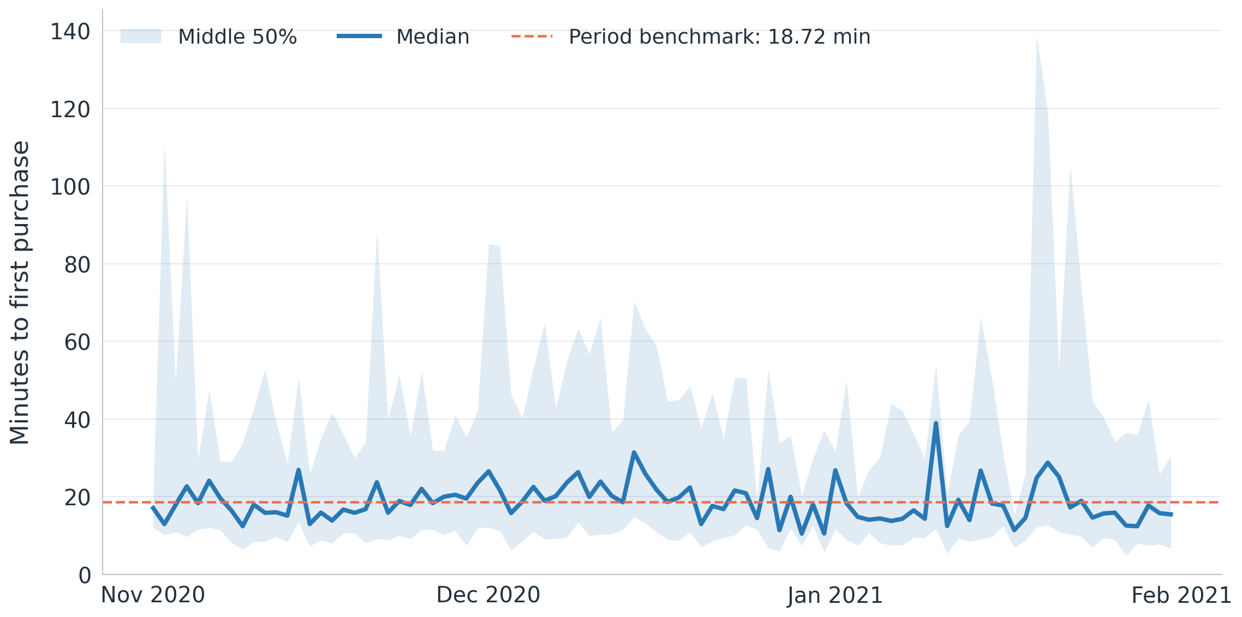
DAILY TREND
Purchase time is stable around 19 minutes on most days.
Across 92 days, the average daily median was 18.72 minutes.
Daily median range: 10.52 to 38.98 minutes.
The middle 50% band widens on some dates.
Low-volume days should be interpreted cautiously.
Notes:
The median is relatively stable across 92 days. Some dates have wider middle-50% ranges. Low-volume days should be interpreted cautiously.

Slide 3
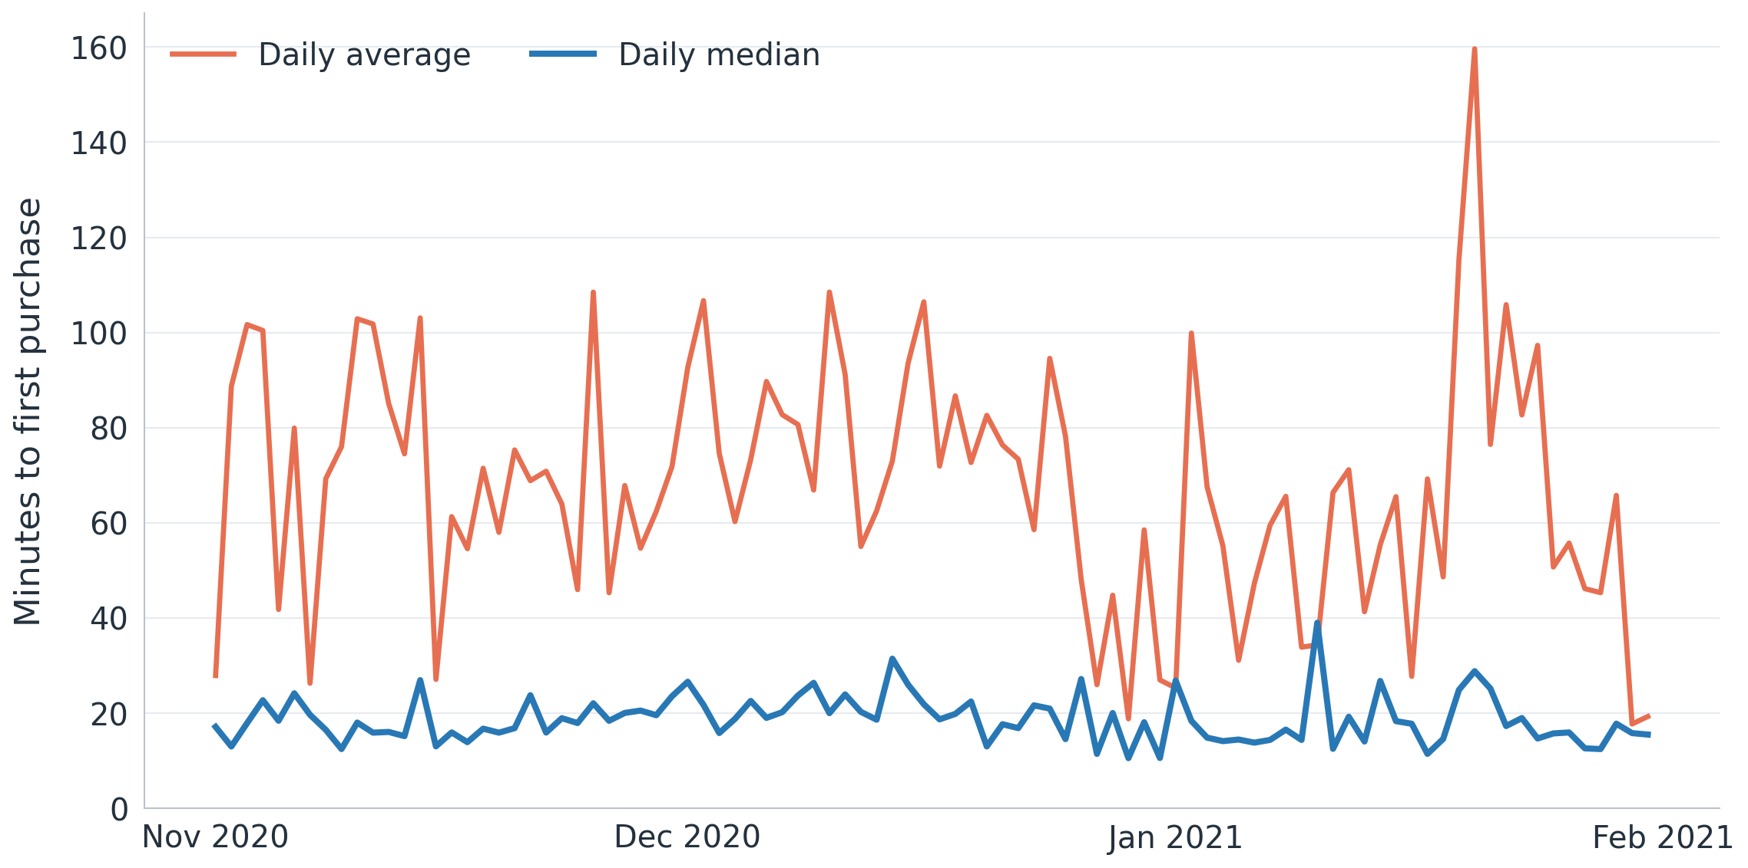
METRIC CHOICE
Average time hides a long tail; median better represents users.
A small number of multi-hour journeys lifts the average far abovethe typical purchase time.
Overall user average: 74.68 minutes
Average daily median: 18.72 minutes
Use median as the headline KPI.
Use p75 and p90 to monitor slower journeys.
Notes:
Across all 4,794 user-level journeys, the average is 74.68 minutes and the median is 19.07 minutes. The chart shows daily averages versus daily medians. A smaller group of multi-hour journeys pulls averages upward, so use median for typical users and p75/p90 for the long tail.

Slide 4
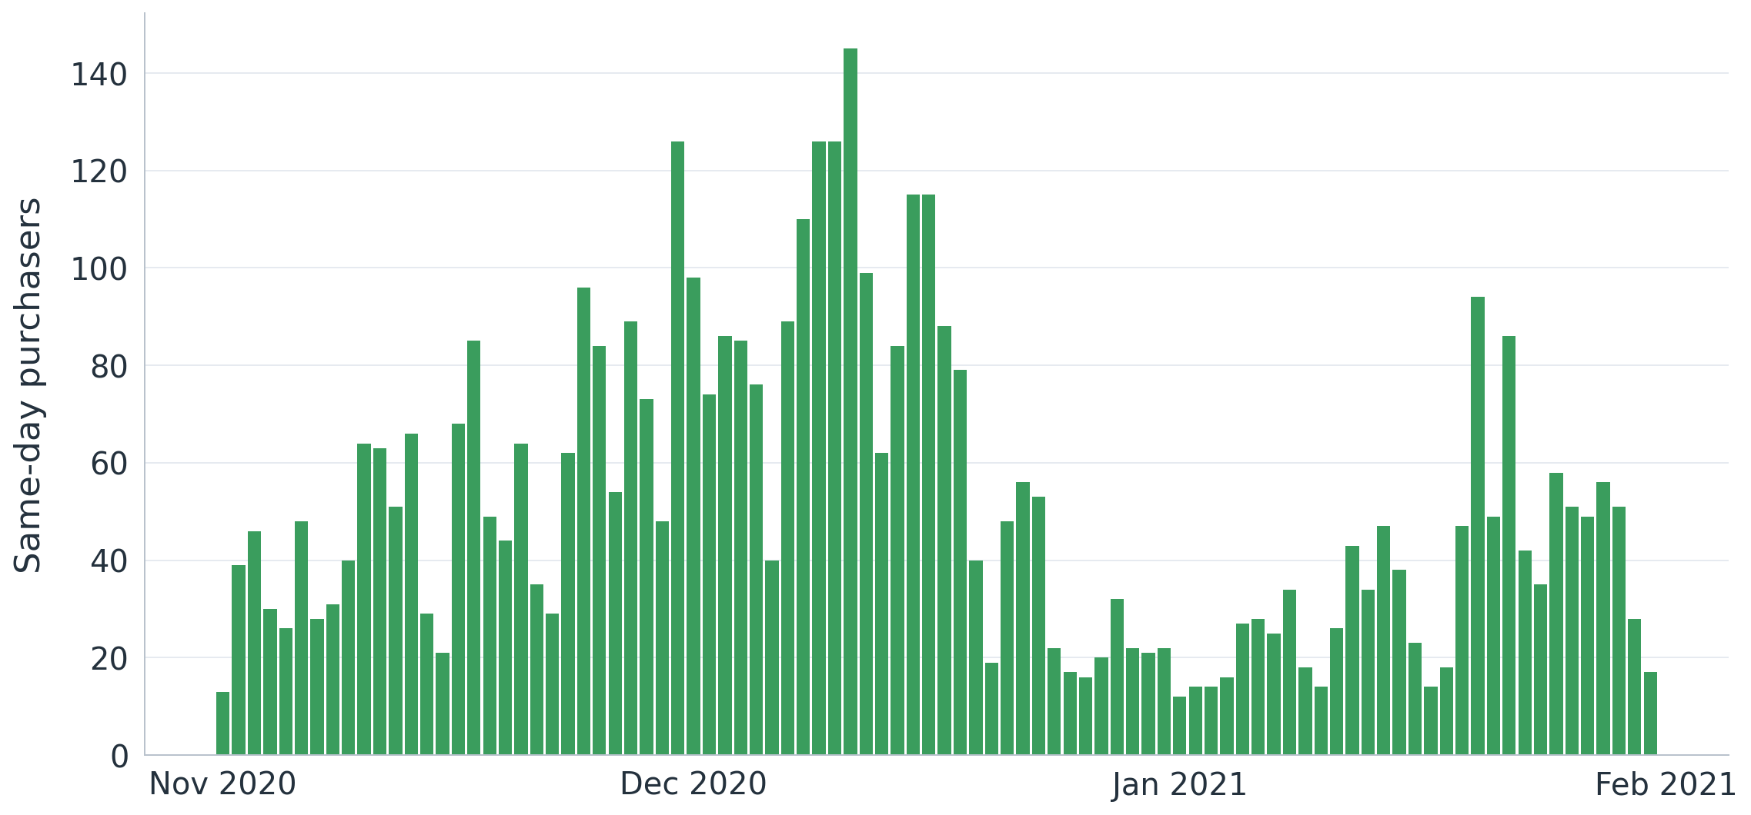
VOLUME SIGNAL
Higher December volume came with only a modest slowdown.
December had the most purchasers and a median about two minutes above November.
Month
N
Time
Nov 2020
1,601
18.2 min
Dec 2020
2,085
20.0 min
Jan 2021
1,108
18.0 min
Notes:
December had the most same-day purchasers and a modest increase in typical duration. Treat this as a monitoring signal, not evidence of a severe slowdown.

Slide 5
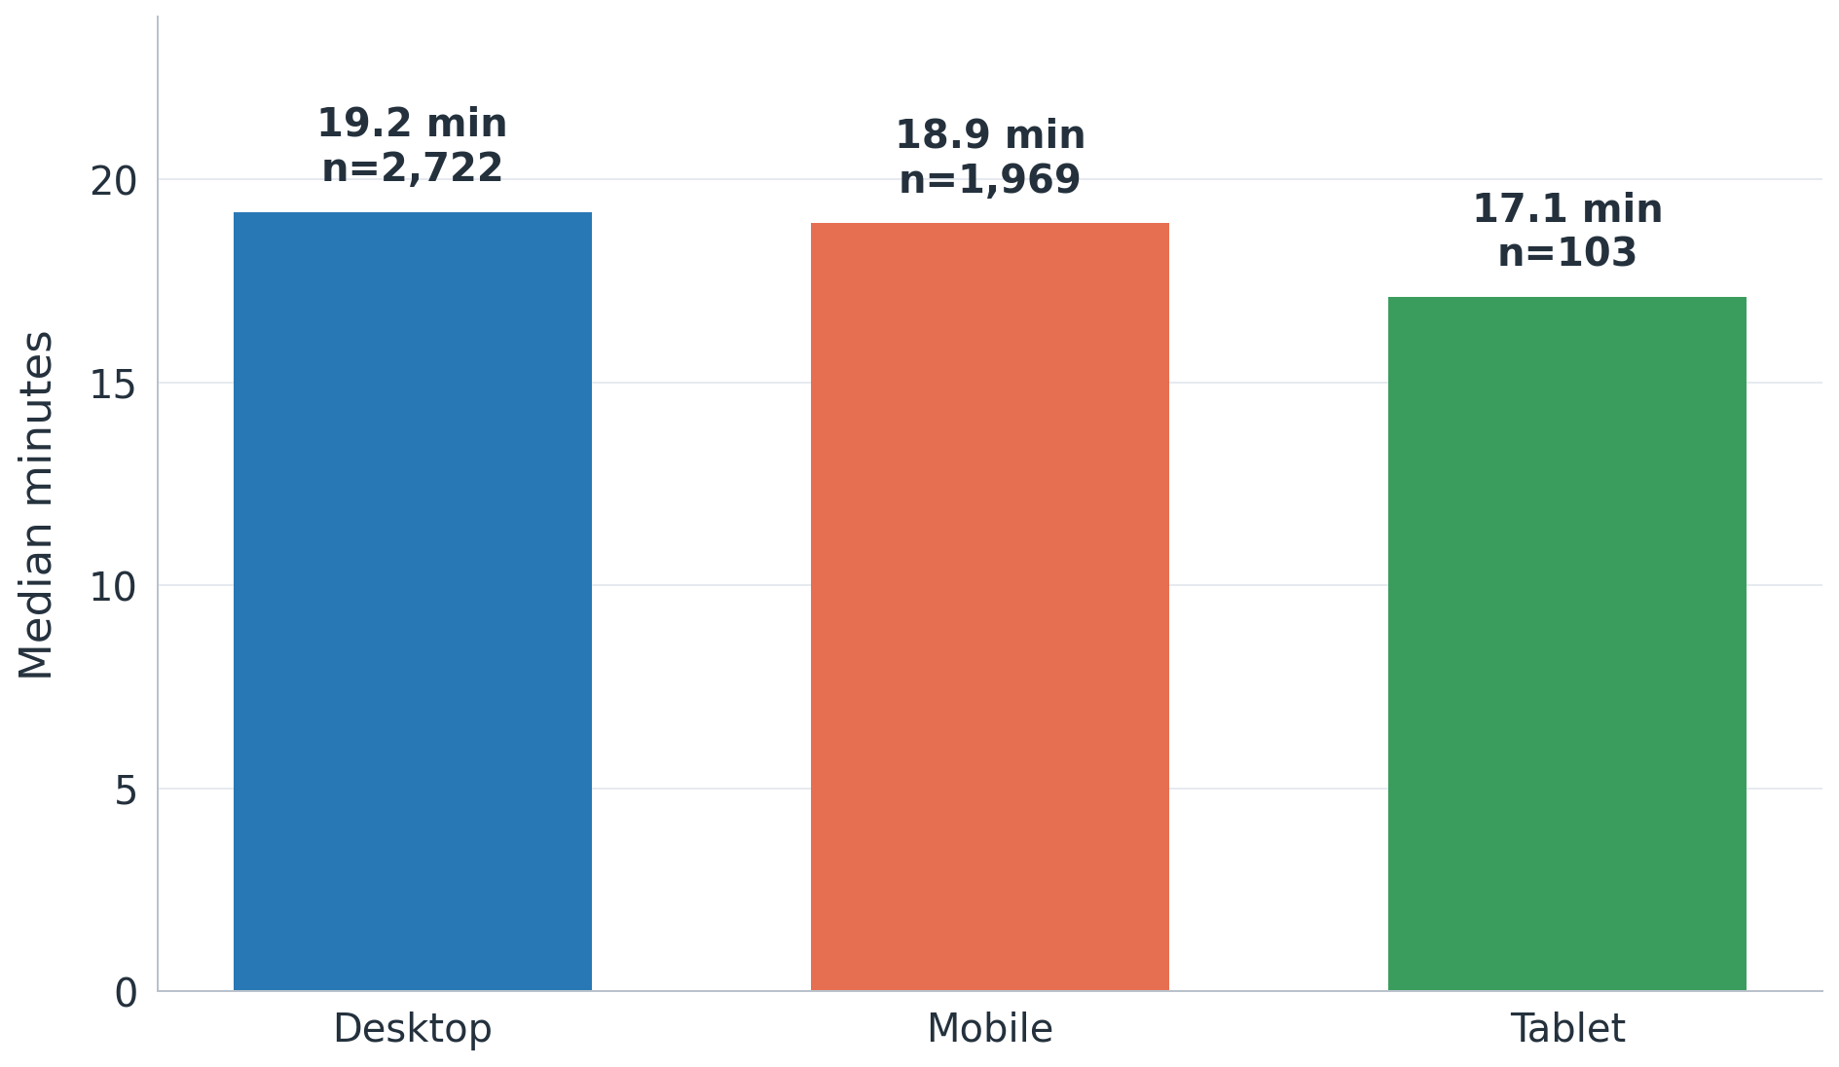
DEVICE CHECK
Desktop and mobile users purchase at nearly the same speed.
The 0.28-minute gap is too small to treat device as the main explanation.
Desktop: 19.20 minutes, n=2,722.
Mobile: 18.92 minutes, n=1,969.
Tablet: 17.10 minutes, n=103.
Device category does not explain the long tail.
Notes:
Desktop and mobile medians differ by only 0.28 minutes. Device category is not the main explanation in the current data.

Slide 6
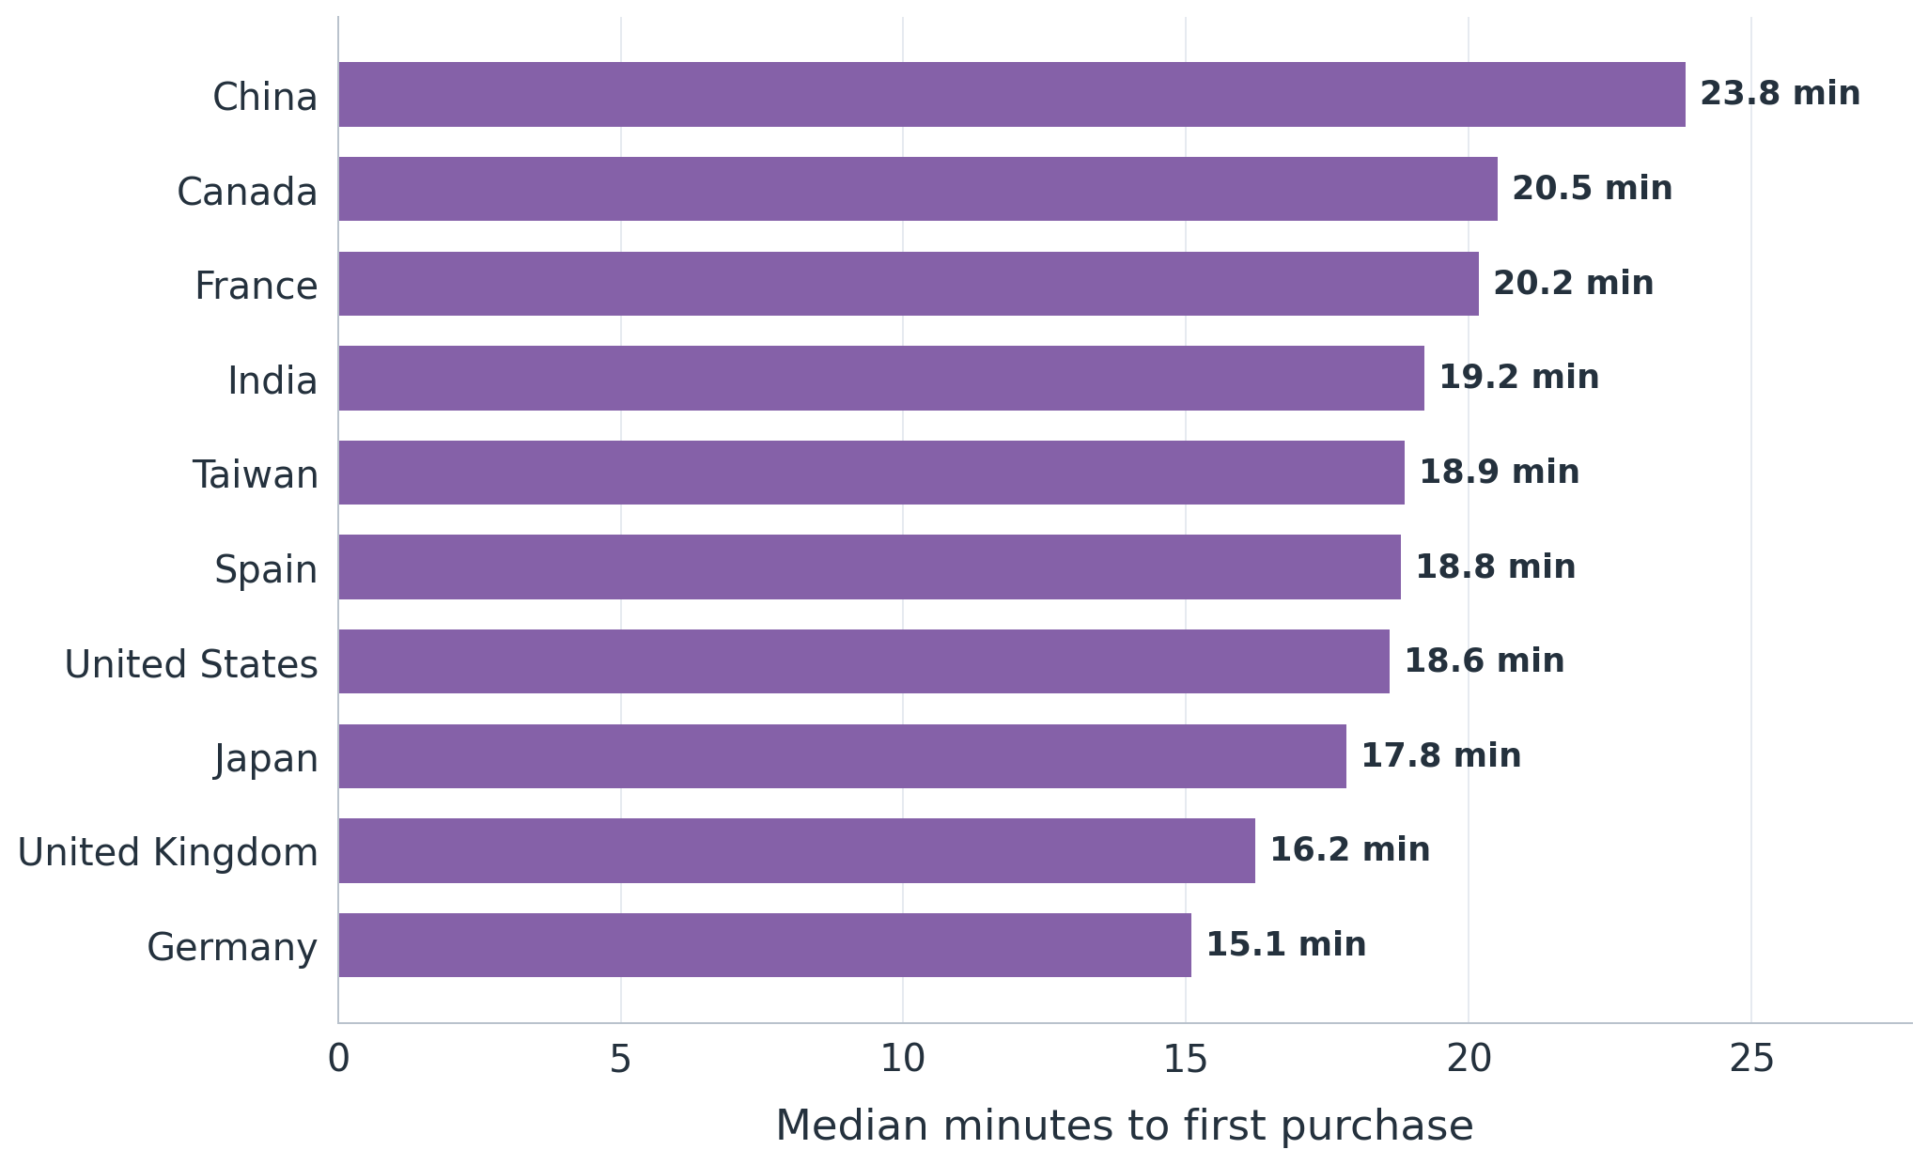
MARKET LEADS
Country differences are leads, not evidence of product failure.
Sample size and traffic mix must be checked before acting on country differences.
United States: 18.60 minutes, n=2,095.
India: 19.21 minutes, n=446.
Canada: 20.51 minutes, n=386.
Slower smaller markets are candidates for follow-up, not conclusions.
Notes:
Country differences identify where to look next, but sample size, traffic source, product mix, language, and intent must be checked before acting.

Slide 7
DECISION BOUNDARY
Known vs. Unknown
The metric supports monitoring, but it does not diagnose slow journeys.
Known
A typical same-day purchaser buys in about 19 minutes.
Desktop and mobile behavior is nearly identical.
Unknown
Which funnel step causes delay.
What happens in journeys that cross midnight.
whether multi-hour durations include inactive tabs.
Notes:
Separate supported findings from unanswered questions. Because the task asks for first arrival on a given day, the first recorded event for each user-date is used as arrival. Dates are derived in UTC, and a local-timezone or session-based definition could change results.

Slide 8
ACTION PLAN
Track median weekly, then investigate funnel-step time.
Use a small KPI set and clear investigation triggers.
Decision: track median, not average.
Monitor weekly median with purchaser count.
Add p75 and p90 to expose the long tail.
Investigate material shifts by funnel step and traffic source.
Validate session logic before operational use.
Use country as a diagnostic split, not a standalone conclusion.
Notes:
Recommend a small monitoring set: weekly median, purchaser count, p75, and p90. Investigate material shifts by funnel step, traffic source, and country after validating session logic.

Slide 9
METRIC APPENDIX
The metric uses one same-day journey per user.
First recorded event to first same-day purchase, summarized by date.
Arrival
Purchase
Duration
First event on that date.
First same-day purchase.
Minutes between both events.
One journey is created for each user and date.
Only users with a same-day purchase enter the duration metric.
Daily summaries include median, average, p25, p75, and p90.
Notes:
Appendix only. Explain that each user contributes one same-day journey per date, avoiding repeated-event overcounting.

Slide 10
SQL APPENDIX
Raw events are transformed into a daily product metric.
The reproducible logic is saved in daily_time_to_purchase.sql.
Raw events
User-day
Duration
Daily
Event data
Arrival + purchase
Minutes
Median + percentiles
Source: tc-da-1.turing_data_analytics.raw_events.
Dates and durations are derived from event_timestamp.
Country and category are direct fields because the table is flattened.
Notes:
Appendix only. Walk from raw events to user-day journeys, duration, and daily summary. The SQL file is included in the submission.

